Slide 1
Proxy Signature

Slide 2
Set up phase
Key-Generation Phase
Private key generation phase
Original signer private key generation phase
Proxy signer private key generation phase
Proxy key generation phase
Proxy signature generation phase
Proxy signature verification phase

Slide 3
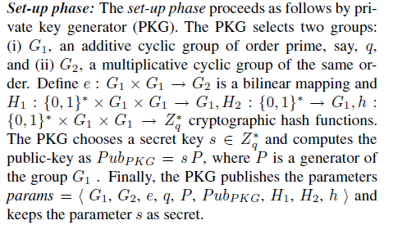
Set-up Phase

Slide 4
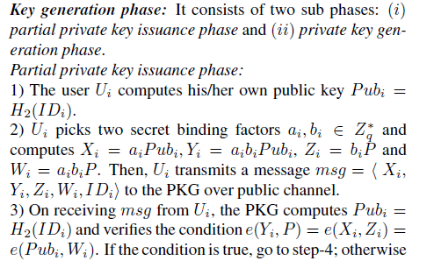
Key Generation Phase

Slide 5
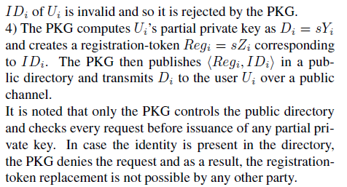
Contd..

Slide 6
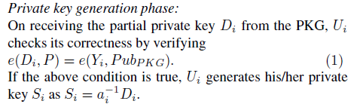
Private Key generation phase

Slide 7
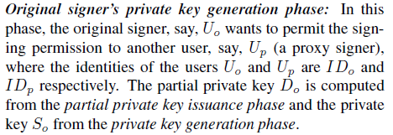
Original signer private key generation phase

Slide 8
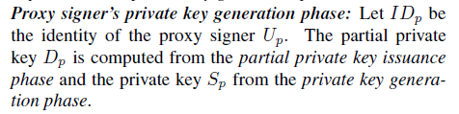
Proxy signer private key generation phase

Slide 9
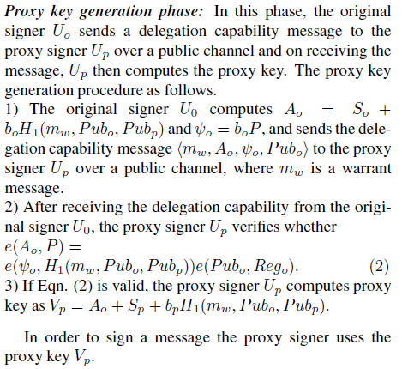
Proxy key generation phase

Slide 10
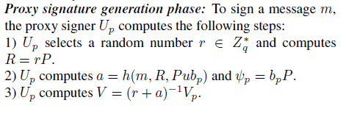

Proxy signature generation phase

Slide 11
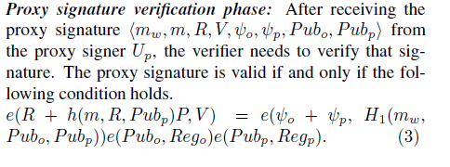
Proxy signature verification

